Slide 1
Notices:
- Get all your data at weather.com! Time automatically sets itself on the blue bar.
Also, this PowerPoint was originally made by seminolefanboy on authorstream: http://www.authorstream.com/Presentation/seminolefanboy-1825303-intellistar-v3-emulator/
And other files such as the images were found by Austin M. On twctoday.com! Me, Christian1023 used this and edited it a lot to make it look better. So enjoy! ☺
Also, the time on the bar automatically updates! Which is a neat feature. Everything else must be typed manually.

Slide 2







Weather Bulletin
THE NATIONAL WEATHER SERVICE
There are no current Special Announcements.
Now
 | --°
 | 76°
Local Weather ID: null
weather.com

Slide 3

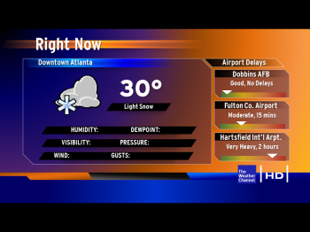


Now
CITY
HUMIDITY | --%
DEW POINT | --°
PRESSURE | ----.- MB
VISIBILITY | - MILES
WIND | --- --
GUSTS | ----
FEELS LIKE | --°
N/A
--
Now
 | --°
Local Weather ID: null
weather.com

Slide 4

Local Doppler Current State
light
heavy
Data Not Available
Now
 | --°
Currently Displaying: null, null.
weather.com

Slide 5

Local Forecast
CITY AREA
Today
Now
 | --°
Weather Notices: null.
weather.com

Slide 6
Local Forecast
CITY AREA
Tonight
Now
 | --°
weather.com

Slide 7
Local Forecast
CITY AREA
Tomorrow
Now
 | --°
weather.com

Slide 8

The Week Ahead
CITY AREA
MON | TUE | WED | THU | FRI | SAT | SUN
N/A | N/A | N/A | N/A | N/A | N/A | N/A
-- | -- | -- | -- | -- | -- | --
-- | -- | -- | -- | -- | -- | --
Now
 | --°
weather.com

Slide 9
5/23/13

